Slide 1
Open OnDemand: Supporting your HPC needs now more than ever
Basil Mohamed Gohar
Web and Interface Applications Manager
This work is supported by the National Science Foundation of the United States under the award NSF SI2-SSE-1534949.

Slide 2
Open OnDemand Overview
About Open OnDemand
Recap
What’s new?
Community experience
Upcoming and Future

Slide 3
About Open OnDemand
Open source software project
Installable for an HPC cluster (or clusters)
Standalone system, Lab, Department, University or National Resources
More than just an “out of the box” solution
OnDemand is a platform that can be extended through additional and custom apps

Slide 4
OnDemand Features
Single point of entry for HPC Center’s services
User needs three things
URL: ondemand.xxx.edu
Username
Password
Zero install (Completely browser based)
Single sign-on
Firewall friendly (Keep traffic on https port)

Slide 5
What sort of things can you do with Open OnDemand?
Access your supercomputer via web
File Browser, File Editor: upload/download, browse edit files
Terminal: connect to a login node command line
Manage Batch Jobs via the web
MyJobs app: create, submit and inspect individual jobs
ActiveJobs app: inspect queues and running job statistics

Slide 6
Open OnDemand Overview
About Open OnDemand
Recap
What’s new?
Community experience
Upcoming and Future

Slide 7
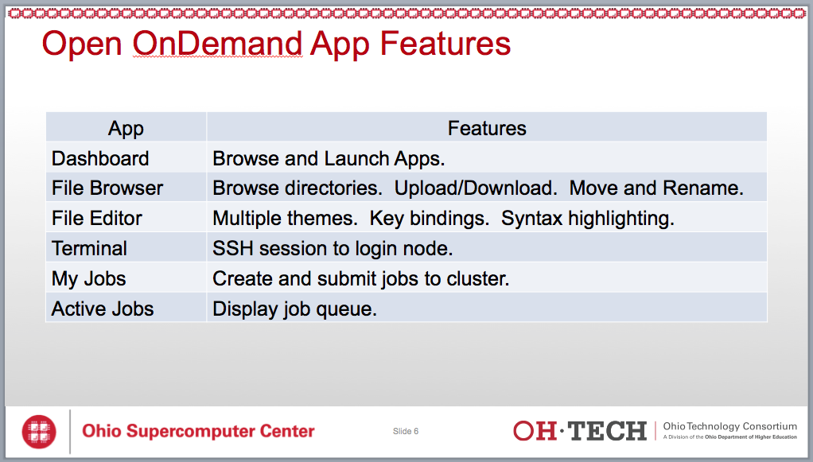
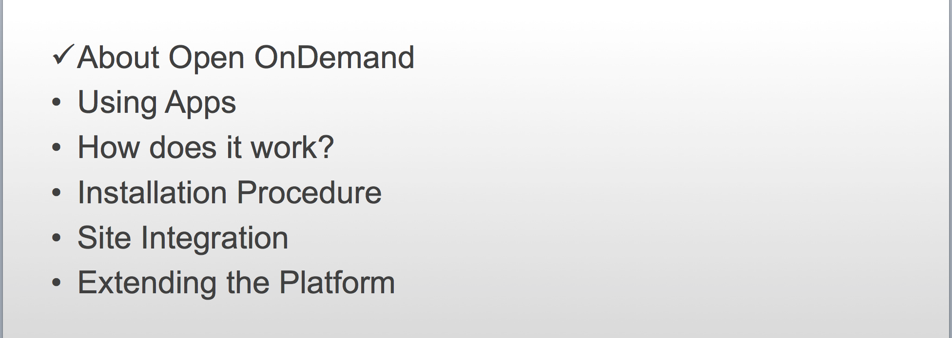
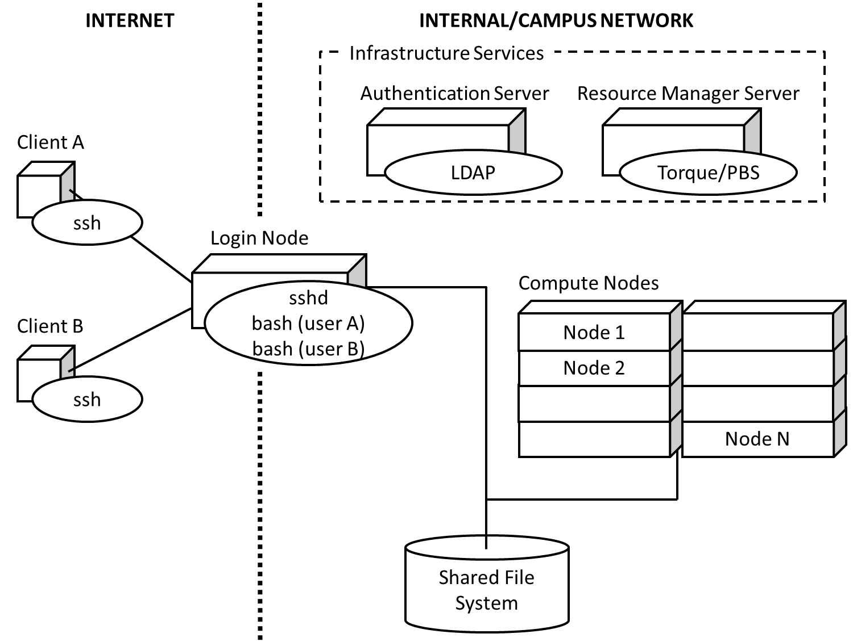
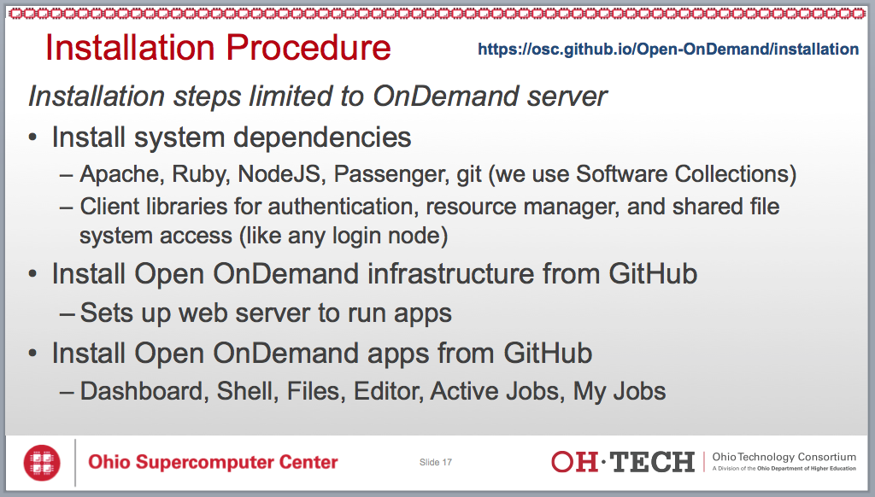
Previously…
First webinar can be found on the Open OnDemand website:
https://osc.github.io/Open-OnDemand

Slide 8
Open OnDemand Overview
About Open OnDemand
Recap
What’s new?
Community experience
Upcoming and Future

Slide 9
Open OnDemand Timeline
2016Q4
OSC OnDemand 3.0 released
First usage of Open OnDemand
Beta testing at external sites begins
2017Q1
First public, fully installable release
First webinar
2017Q2
Second webinar

Slide 10
What’s new?
MOTD support
Simpler installation
App installation with a single script
Interactive Desktop support
Linux Desktop (e.g., GNOME, MATE)
Custom desktop applications
Additional resource manager support
Slurm
LSF

Slide 11
What’s new?
Installation Overview
Motivated by making the process easier
Found opportunities to make installation smoother and simpler for admins
Many steps reduced to a single step
Released on April 27th, 2017

Slide 12
What’s new?
Interactive Desktop Demonstration

Slide 13
What’s new?
External install and Slurm demo by PSC

Slide 14
Open OnDemand Overview
About Open OnDemand
Recap
What’s new?
Community experience
Upcoming and Future

Slide 15
Community experience
In addition to PSC, we also have installs at at a handful of other locations that we know about
If you’ve tried it and we don’t know, please let us know!
Feedback
Resource managers (Slurm & LSF)
Theming/Branding
2FA
CILogon
X11
VNC

Slide 16
Open OnDemand Overview
About Open OnDemand
Recap
What’s new?
Community experience
Upcoming and Future

Slide 17
Upcoming and Future
PEARC17 BoF – Come meet us!
Wednesday, July 12 • 4:00pm - 5:00pm
http://sched.co/Ax2T
Upcoming features
App development
Graphical desktop applications
Paraview, MATLAB, Abaqus, ANSYS Workbench, COMSOL Multiphysics
Interactive web applications
Jupyter, RStudio Server, COMSOL Server
New and customized apps
Suggestions?

Slide 18
Next Webinar/Staying in Touch
Our webinars are planned roughly quarterly
Let us know what you’d like to learn about next
Visit our website
https://osc.github.io/Open-OnDemand/
Join our mailing list
https://lists.osu.edu/mailman/listinfo/ood-users
Get Open OnDemand!
https://github.com/OSC/Open-OnDemand

Slide 19
Thank you! Any questions?
Basil Mohamed Gohar
Web and Interface Applications Manager
Ohio Supercomputer Center
bgohar@osc.edu
https://osc.github.io/Open-OnDemand/
go.osu.edu/ood

